Slide 1
EDA
Exploratory Data Analysis

Slide 2
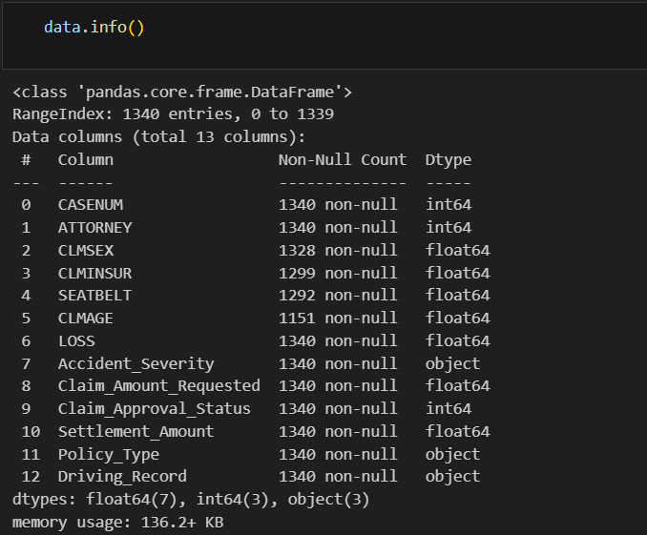
DATASET INFORMATION

Slide 3
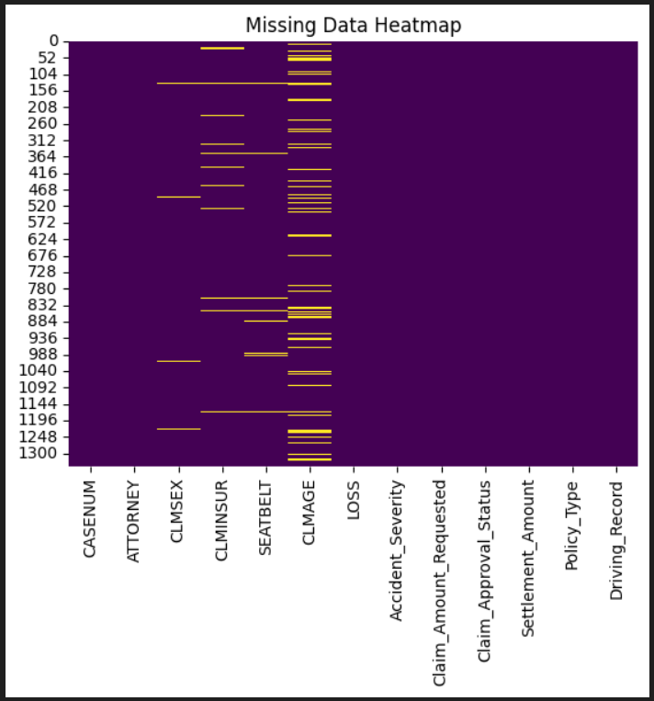
HEATMAP : Missing data

Slide 4
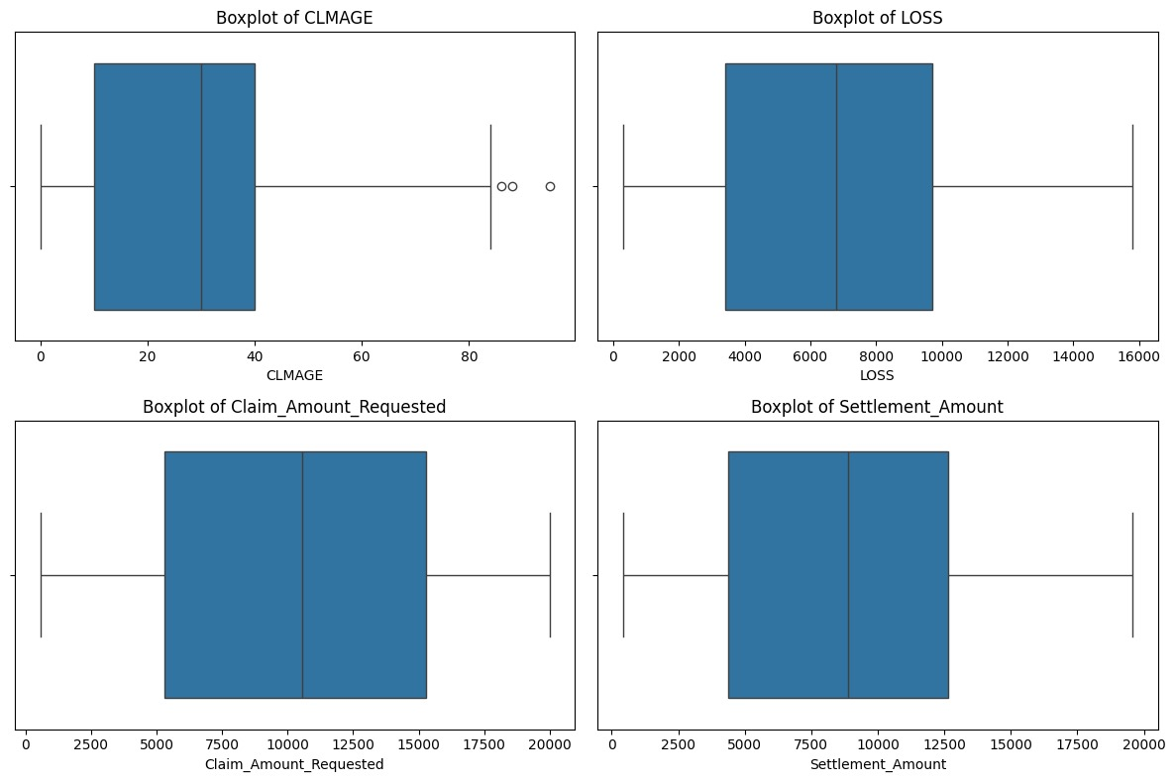
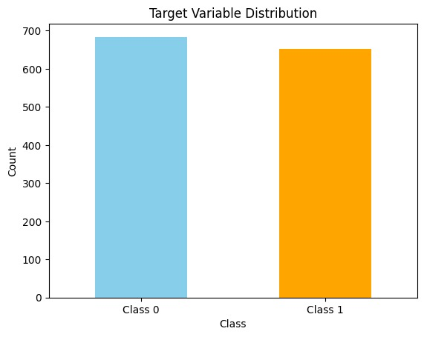
VISUALIZATIONS

Slide 5
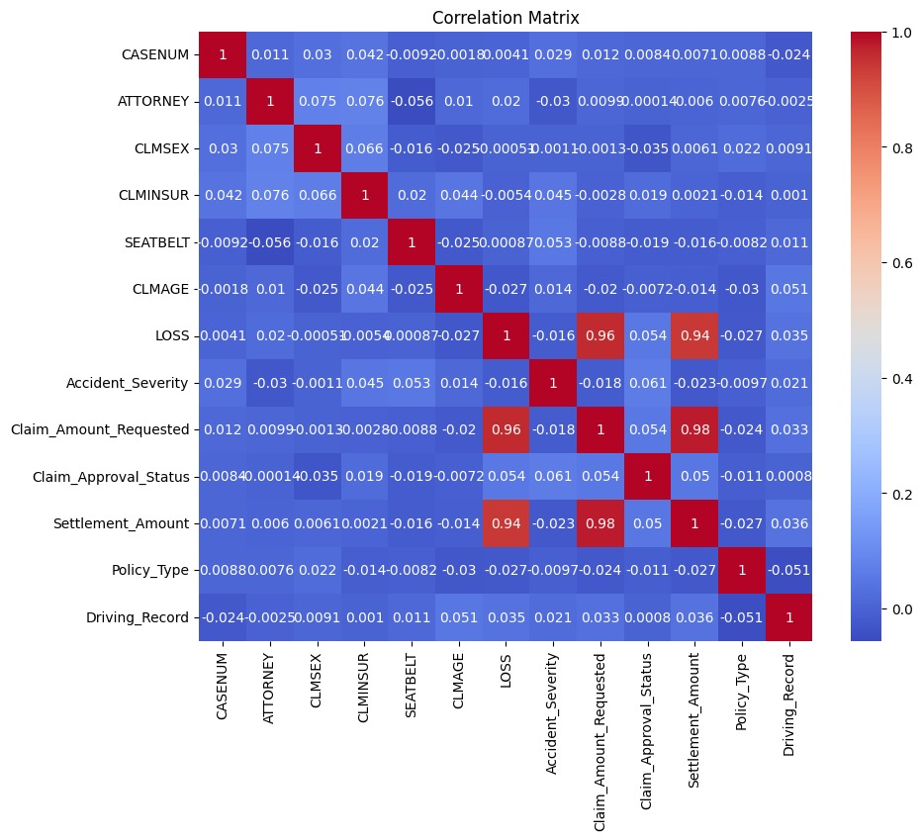
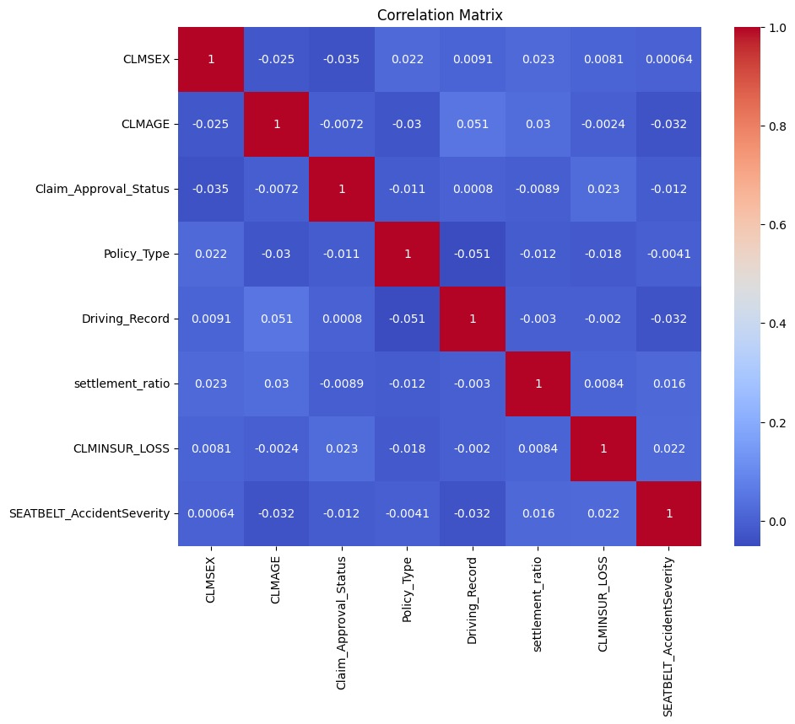
CORRELATION MATRIX AND HEATMAP

Slide 6
MODEL BUILDING
PROCESS

Slide 7
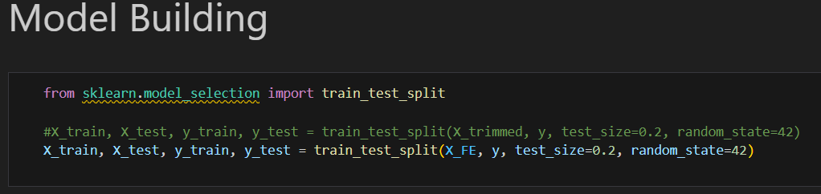
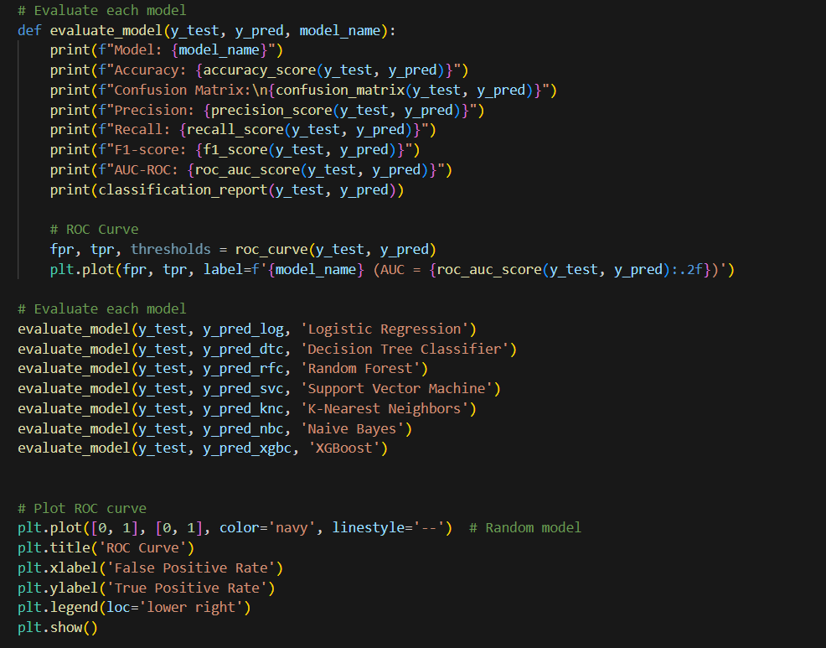

Slide 8
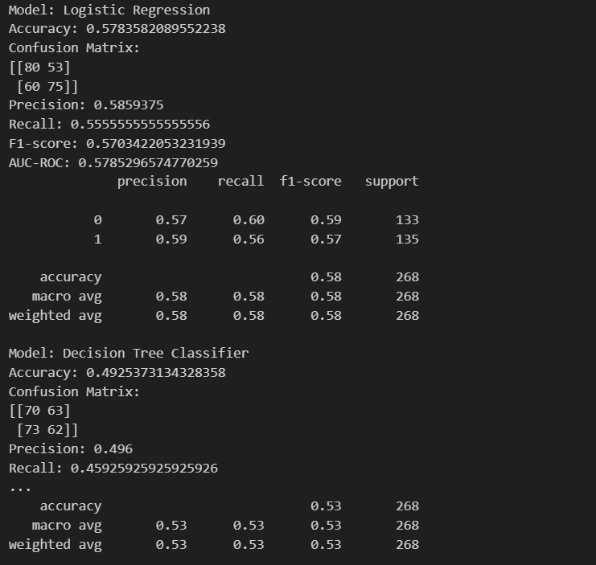

Slide 9
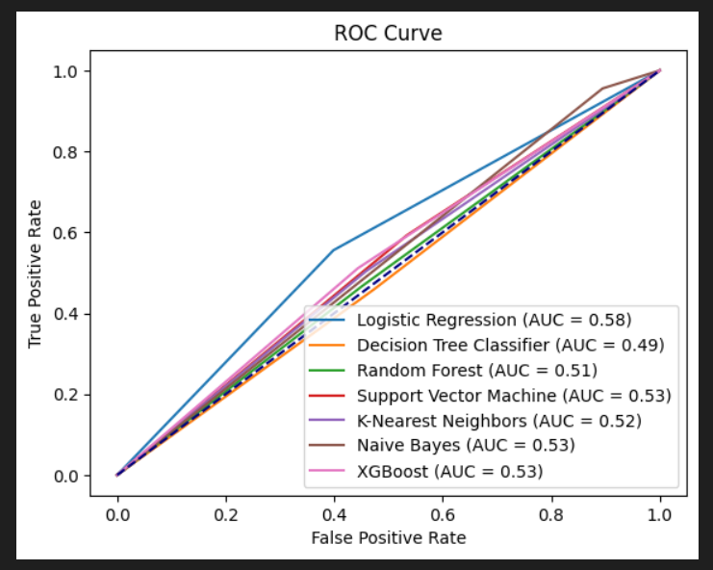
ROC CURVE

Slide 10
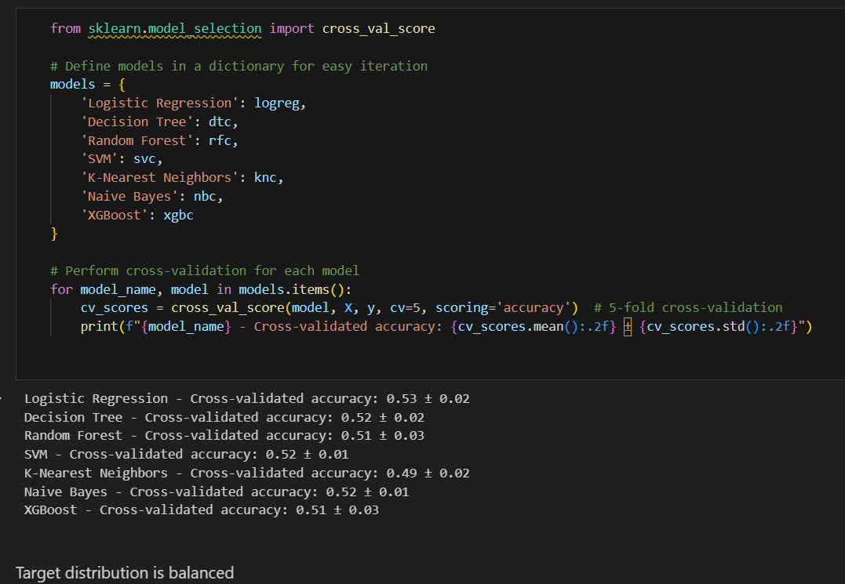
Target distribution is balanced

Slide 11
HYPERPARAMETER
TUNING

Slide 12
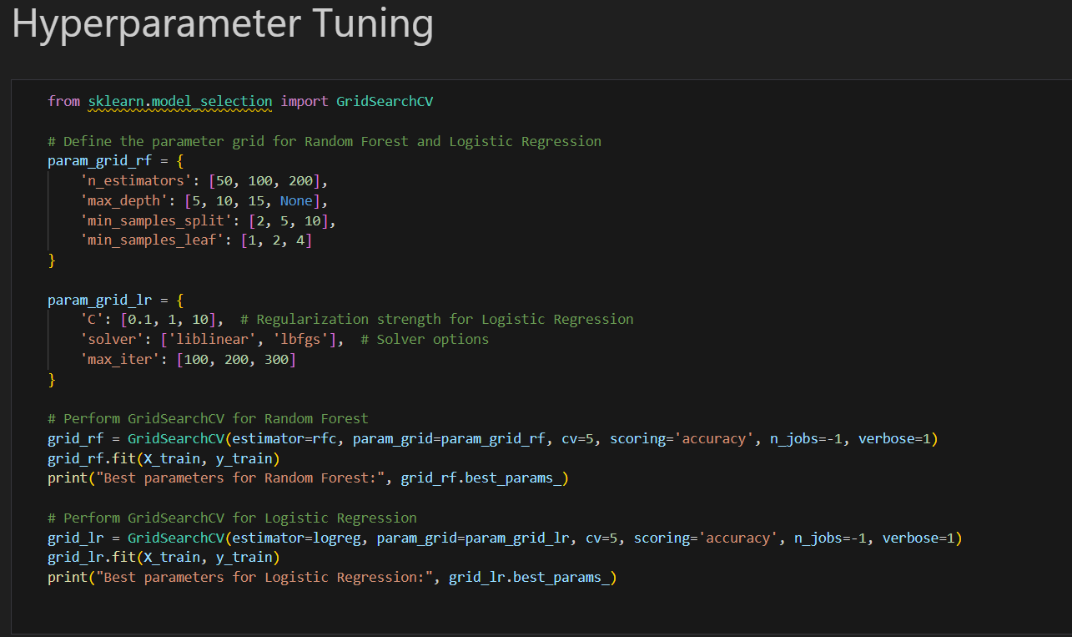

Slide 13
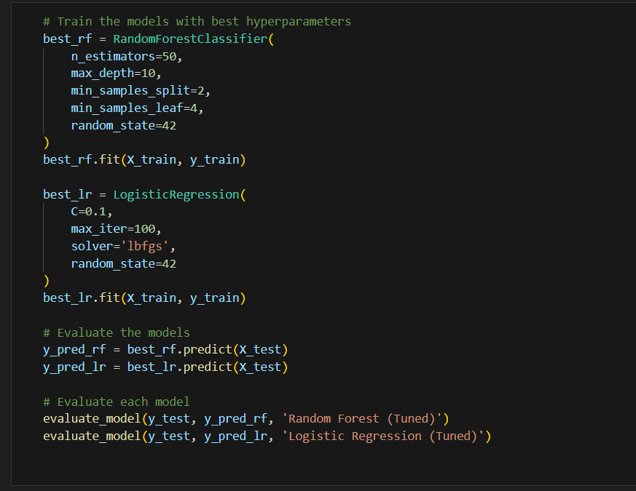

Slide 14
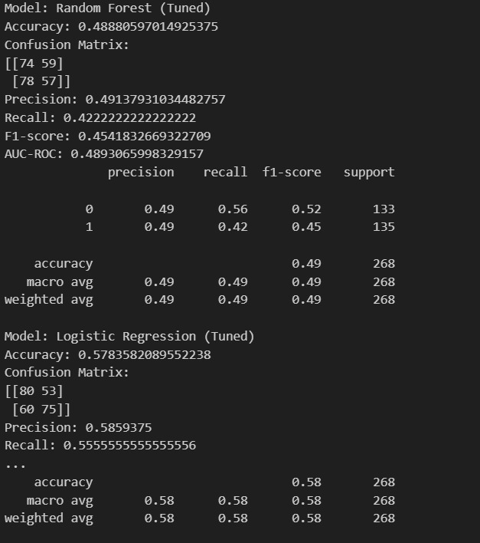

Slide 15
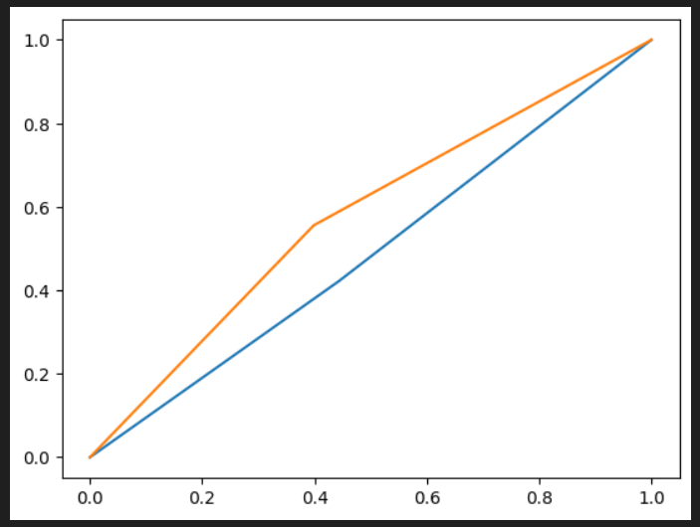
ROC CURVE

Slide 16
CONFUSION MATRIX
LOGISTIC REGRESSION

Slide 17
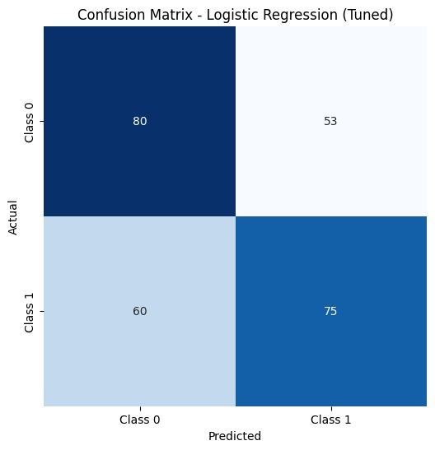

Slide 18
CONFUSION MATRIX
RANDOM FOREST

Slide 19
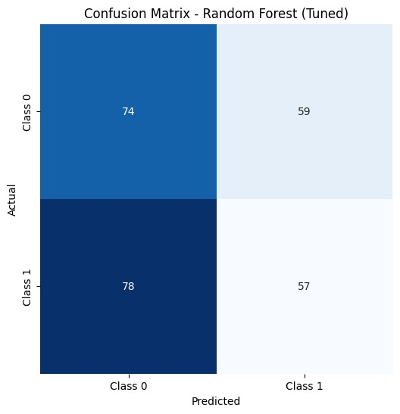

Slide 20
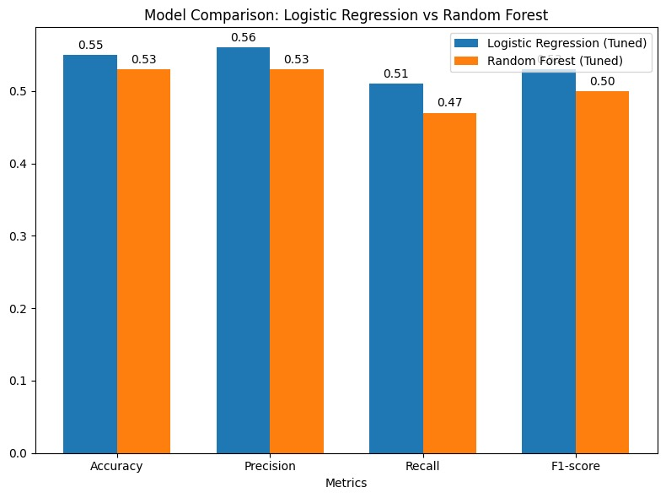
MODEL COMPARISION

Slide 21
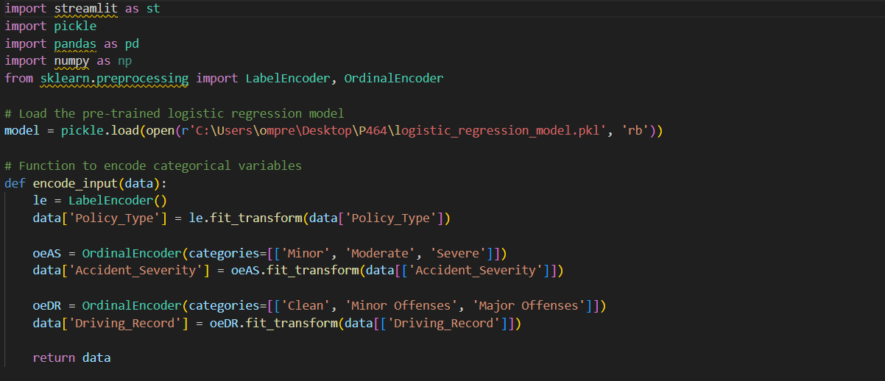
DEPLOYMENT

Slide 22
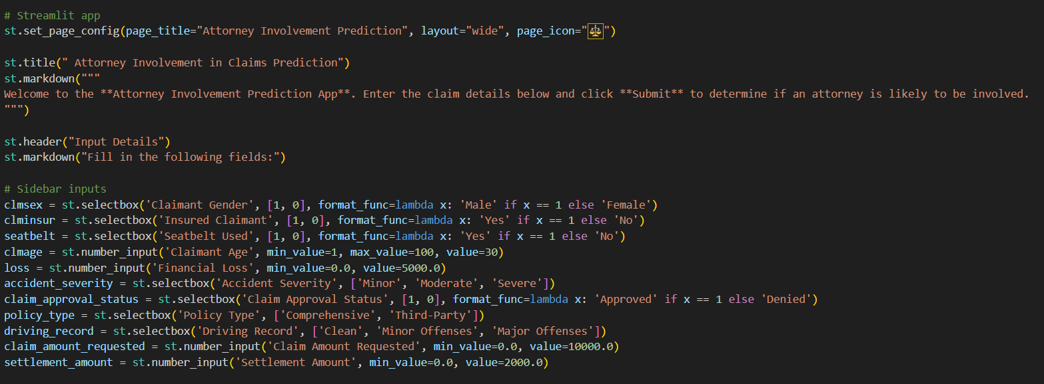
STREAMLIT CONFIGURATION

Slide 23
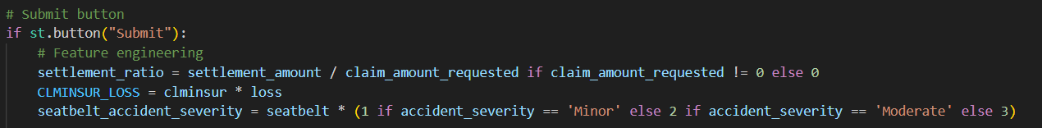
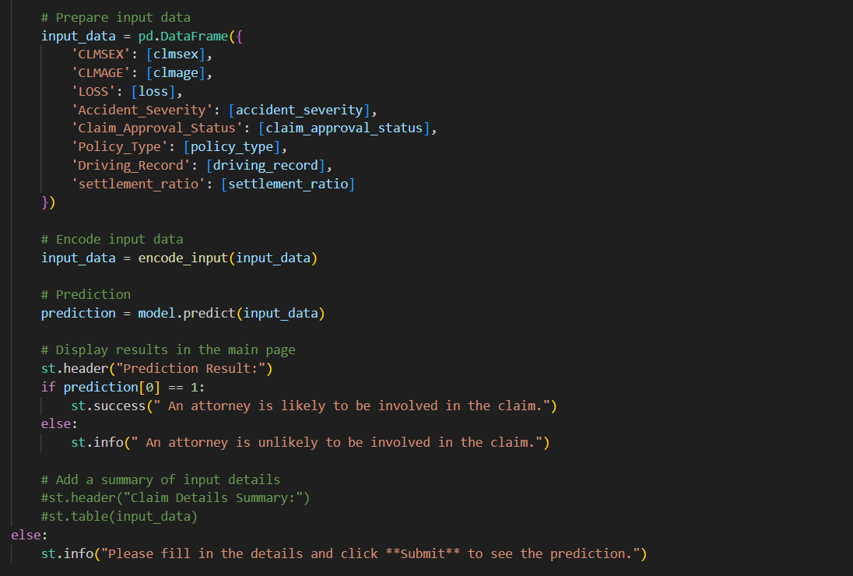

Slide 24
PREDICTION RESULTS THROUGH STREAMLIT
USING COMMAND PROMPT

Slide 25
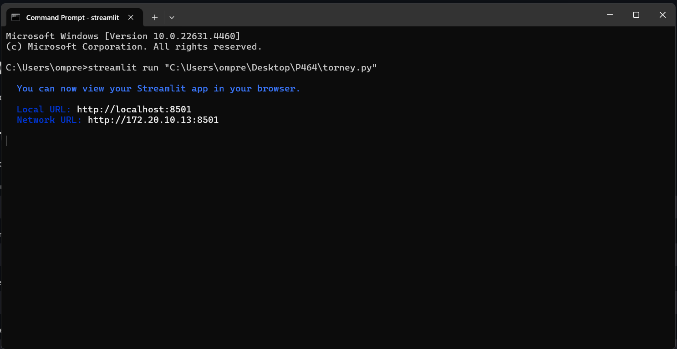

Slide 26
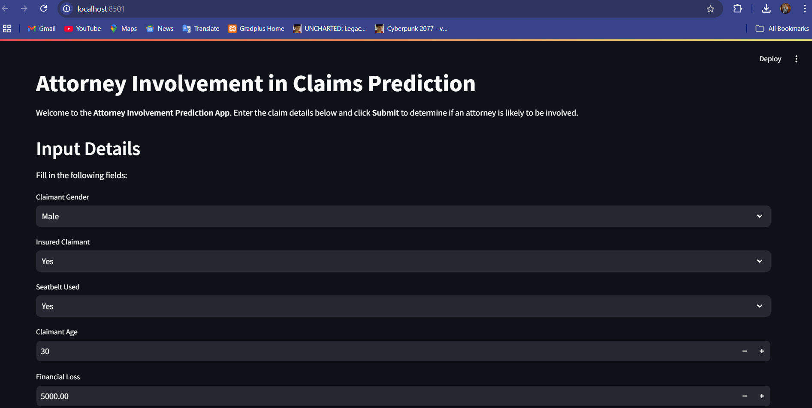
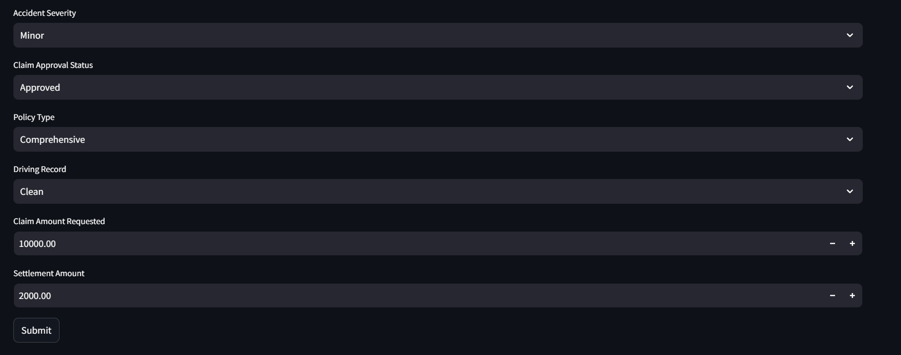

Slide 27

PREDICTION RESULT

